Slide 1
Objectivity and Subjectivity
Objective refers to an unbiased and balanced statement that represents facts about something.
The statement is not coloured by the past experiences, prejudices, perceptions, desires or knowledge of the speaker. Therefore, they are independent and external to the mind of the specific person.
A subjective point of view is characterized by the past experiences, knowledge, perceptions, understanding and desires of the specific person.
These statements are exclusively based on the ideas or opinion of the person making it.

Slide 2
Comparison Chart
BASIS FOR COMPARISON | OBJECTIVE | SUBJECTIVE
Meaning | Objective refers to neutral statement which is completely true, unbiased and balanced. | Subjective means something which does not shows clear picture or it is just a person's outlook or expression of opinion.
Based on | Facts and observations | Assumptions, beliefs, opinions.
Truth | Provable | Subject relative.
Verification | Verified | Non-verified
Reporting | Same | Varies to a great extent, from person to person, day to day.
Decision making | Yes | No
Used in | Textbooks and encyclopedias | Blogs, comments on social media and biographies.

Slide 3
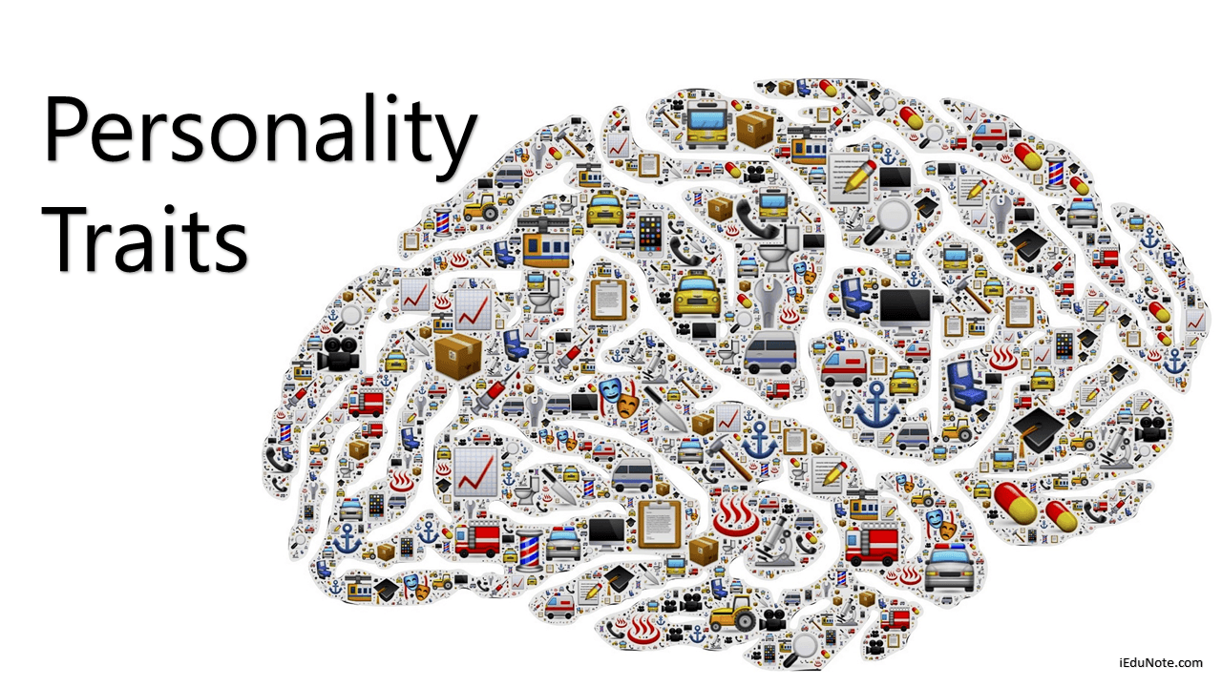

Slide 4
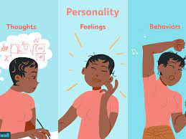
Personality
The word personality itself stems from the Latin word persona, which refers to a theatrical mask worn by performers in order to either project different roles or disguise their identities.
At its most basic, personality is the characteristic patterns of thoughts, feelings, and behaviours that make a person unique.

Slide 5
It exhibits the quality of a person, which is visible and impresses or disturbs others.
Personality of an individual is unique, personal and a major determinant of his behaviour.
Because of differences in personality, individuals differ in their manner of responding to different situations.

Slide 6
Characteristics
Personality is something which is unique in each individual.
Personality refers particularly to persistent qualities of an individual.
Personality represents a dynamic orientation of organism to environment.
Personality is greatly influenced by social interactions.

Slide 7
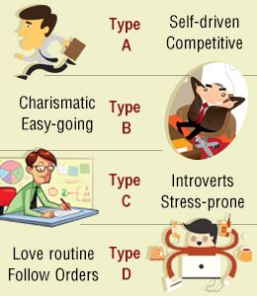
Types of Personality

Slide 8
Type A Personalities
Type A individuals are multitasking, ambitious, proactive, organized and status-conscious individuals.
They set strict deadlines and achieve those deadlines because of their inner driving force.
They are sympathetic, sensitive, truthful and always eager to help others. Type A people are friendly and caring,
but they cannot sit for long periods of time and chit-chat about "nothing".

Slide 9
Type A
Pros
Multi- tasker
High Achiever
Goal-Driven
Perfectionist
Sensitive
Energetic
Competitive
Practical
Cons
Easily Overwhelmed
Overachiever
Workaholic
Perfectionist
Anxious
Stressed
Competitive
Impatient

Slide 10
Type B Personalities
People with Type B traits are laid-back individuals. They have the ability to relax, enjoy small accomplishments.
They tend to be calm, patient individuals and are generally uncompetitive as they often take the
"win some, lose some" approach.
Although Type B personalities are still planners by nature, they rarely complain or stress about the outcome of those plans should they not turn out exactly as anticipated.

Slide 11
Type B
Pros
Realistic
Accepting
Easy-Going
Tolerant
Relaxed
Uncompetitive
Innovative
Reflective
Cons
Unmotivated
Complacent
Procrastinator
Indulgent
Overly Casual

Slide 12
Type C Personalities
To be brief, people with Type C personalities are perfectionists.
They are consistent and will never break the rules. Unlike Type A's, Type C personalities tend to take their time with the details and often check and recheck their work for accuracy.
Type C people are considered emotionally repressed because they have a hard time sharing their emotions, feelings and/or needs with others. For this reason, they often come across as uncaring or have a similar "I don't care" attitude as that of Type B's.

Slide 13
Type C
Pros
Reliable
Consistent
Thoughtful
Patient
Perfectionist
Diligent
Detail-Oriented
Cautious
Cons
Unassertive
Pushover
Emotionally Repressed
Subdued
Perfectionist
Critical
Stress-Prone
Cautious

Slide 14
Type D
Type D people are often the ones who others turn to when looking for support.
Compassionate individuals by nature, they tend to make some of the best friends and confidants.
They generally have a negative view of life and are always suppressing their emotions.
But if they are able to avoid the downfalls of their personality traits (e.g. depression and negativity), Type D people can be very happy individuals in their routine lives.

Slide 15
Common Challenges of Being Type D
Challenges & Possible Solutions:
Overly Routine-Oriented: Try introducing small changes to your routine and slowly working up from there.
Over thinking: Empty your mind of negative or anxiety-inducing thoughts by journaling or pouring your emotions into creative work.
Socially Inhibited: Practice expressing yourself with your close friends until it starts to feel easier to open up to people.

Slide 16
Overly Cautious: Take one little risk each day (even something as small as trying a new flavour of ice cream) to help build your confidence.
Depression- and Worry- Prone: Increase your activities and exercise (even if that's the last thing you feel like doing) and try to reframe the way you think about and respond to potentially negative events in life.
Pessimistic : Learn to accentuate the positive by writing down three good things about your day before you go to sleep each night.

Slide 17
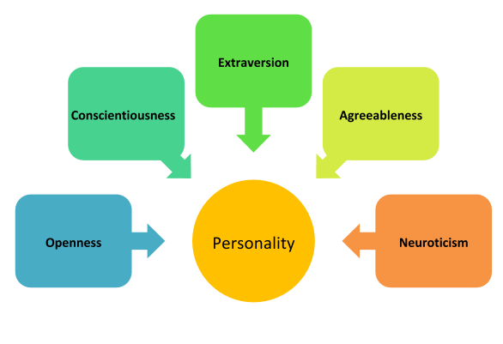
Big Five Personality Traits:OCEAN

Slide 18
Openness: A degree of intellectual curiosity, creativity, and a preference for novelty.
Being creative & open to new ideas
The Openness dimension refers to a person’s intellect or imagination. This dimension is meant to assess a person’s creativity and desire to adapt to explore new things. The dimension is meant to assess one’s openness to experience, such as; aesthetic sensitivity, intellect, curiosity, etc.
2. Conscientiousness: A tendency to be organized.
This implies the desire of an individual to do the task correctly. Conscientiousness is the dimension for assessing one’s diligence, efficiency and the ability to be organized. A high score for conscientiousness implies self-discipline.
Whereas, a low score implies spontaneous behavior and even a lack of reliability.

Slide 19
3. Extraversion: A tendency to seek the company of others and talk.
The Extraversion dimension measures if an individual is more open to external interactions or prefer being low-key.
Extroverts are perceived as people with high energy levels, whereas introverts prefer more time alone and need time to warm up.
4. Agreeableness: A measure of one’s trusting and helpful nature.
This trait reflects social harmony or the lack of it. Agreeable people are considered as benevolent, trusting, helpful and willing to compromise for the greater good. Whereas, disagreeable individuals are seen as selfish, sceptic and unfriendly.
5. Neuroticism: Predisposition to psychological stress.
This is a measure of a person’s ability to feel negative emotions like anxiety, and anger. In other words, Neuroticism measures a person’s emotional stability.

Slide 20
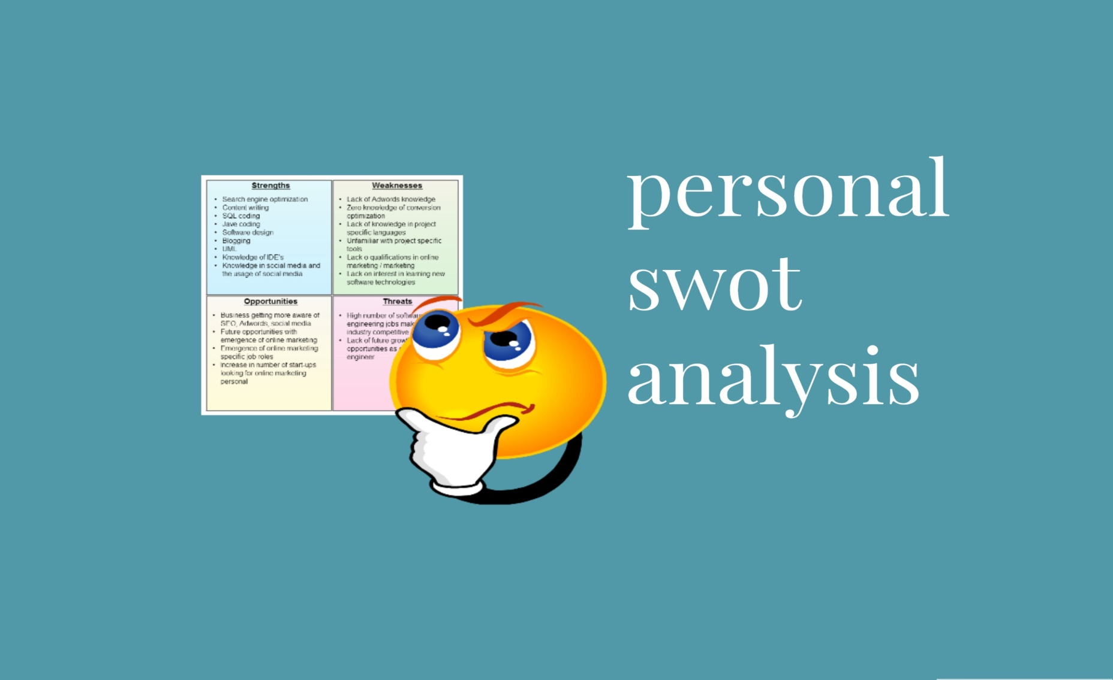
Ways to identify Self

Slide 21
SWOT Analysis
Personal SWOT analysis is a great self-assessment tool to assess yourself in order to plan your career.
The tricky part is finding a job you love that matches your skill set and of course pays well. SWOT Analysis helps in finding the solution to this problem also.
SWOT Analysis is the process of examining your Strengths and Weaknesses, and also Opportunities and Threats.

Slide 22


Slide 23
1 Strengths
1) What are the professional qualifications/certifications you have that make you stand out of the queue?
2) Do you have expertise in some areas that can make a difference?
3) How are your communication skills?
4) How many languages can you speak?
5) Do you have an adaptive nature or not?
6) What do others think of your strengths?

Slide 24
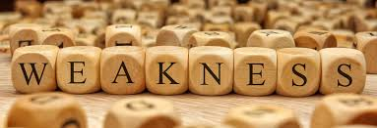

Slide 25
2 Weaknesses
1) Do you have the necessary skills or qualifications to be successful in your field?
2) Do you have any bad habits such as getting late, poor communication skills, etc.
3) Do you have enough confidence to face interviews and meetings?
4) Do you face language as a barrier to effective confidence?
5) Do you have personality traits that hold you back in your field?
6) What are your weaknesses?

Slide 26


Slide 27
3 Opportunities
1) Are there any advancements or changes in your industry that you can take advantage of?
2) Upcoming technology in the emerging trend that you can make use of.
3) New Positions in organizations that match your skills.
4) Can acquiring new skills give you a competitive advantage?

Slide 28


Slide 29
4 Threats
1) What obstacles (Professional standards) do you currently face at work?
2) Are any of your colleagues competing with you for projects or roles?
3) Is your job dynamic i.e. changing in nature.
4) Does change Technology is threatening your position?
5) Could any of your weaknesses lead to threats?
6)Are there any new Training, education or Certification requirements that impede your progress?

Slide 30
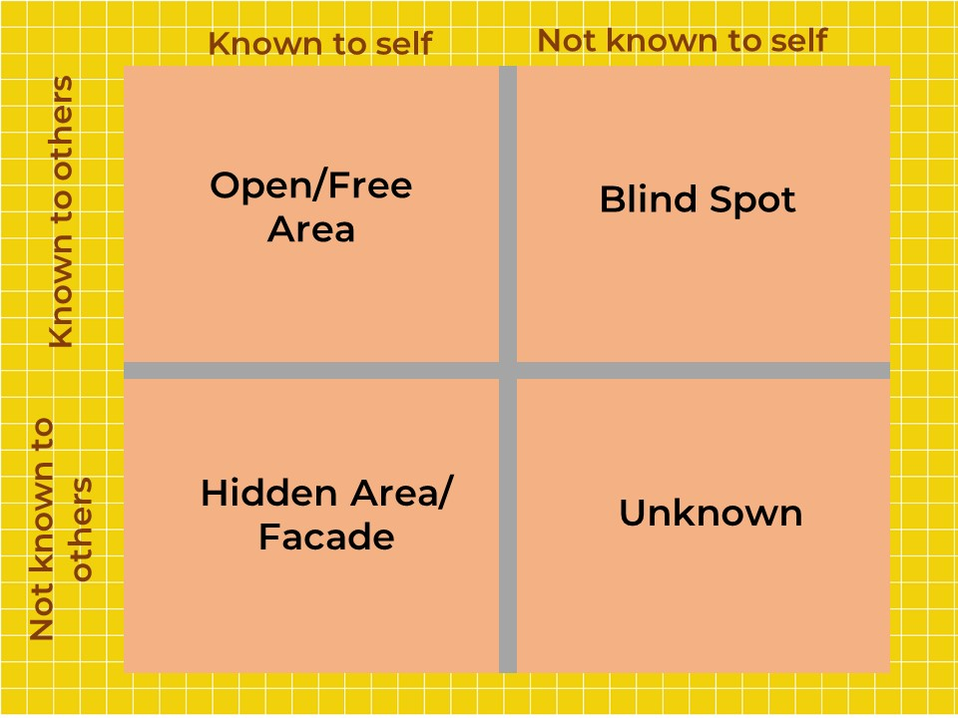
The Johari Window

Slide 31
The Johari Window
A core premise of the model is that our interactions with others are ultimately shaped by:
How we see ourselves, and
How we are perceived by others.
If both views are aligned, then the interaction is more likely to be effective and engaging.

Slide 32
There are four assumptions
There is information that is known to only me.
There is information that is known to only you (or, whoever you’re communicating with).
There is information that is known to you and me.
There is information that neither of us know.

Slide 33
The four panes of the Johari window
Open area (known to self, known to others) –
this area contains well-known information that most individuals are happy to talk about.
It encompasses skills, values, experience, personality, values, and feelings.
Blind area (not known to self, known to others) –
or things that people know about us that we are unaware of. Information is often withheld for fear of hurting feelings or starting an argument. In a business context, this area includes blind spots that are crucial for professional development. They can be both positive and negative traits.

Slide 34
Hidden area (known to self, not known to others)
commonly referring to information that the individual chooses not to disclose.
These may include fears or ambitions that are withheld for fear of reprisal or judgment.
Unknown area (not known to self, not known to others)
as the name suggests, this is information unknown to either party.
It may relate to talents or abilities that, through a lack of opportunity or confidence, have not yet been discovered.

